Slide 1
Browser Storage
JavaScript

Slide 2
Cookies

Slide 3
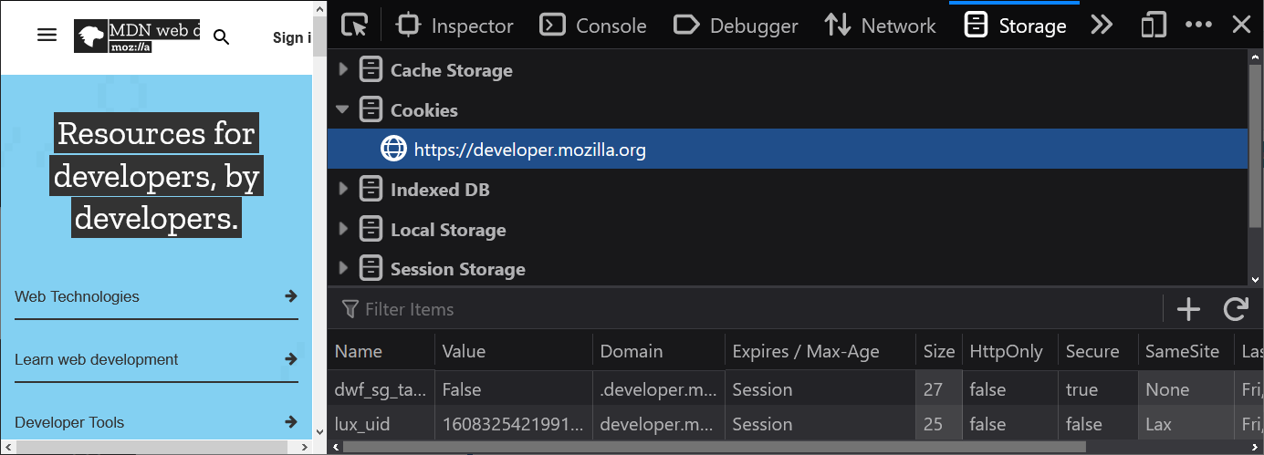
What is a Cookie?
A cookie is an origin-specific key and value pair, kept track of by the browser.
Origin-specific means, put simply, that you will have a different set of cookies available when visiting Google.com versus visiting Facebook.com, as an example. There are exceptions to this, referred to as “third party cookies” which may be phased out soon.
The browser typically won’t reveal cookies set visiting one domain to a web server of another.
You can see which cookies are active in any website you visit via your browser’s developer tools.
If you’re using Firefox, cookies should be available via a dropdown in the “Storage” tab.
For Chrome and Edge, the “Cookies” dropdown should be available under the “Application” tab instead.
Notes:
Note the “Name” and “Value” columns. These are essentially “key” and “value” pairs. They work much like variables… a name representing a value that may change.
Notably, cookies always have some sort of an expiration date.

Slide 4
Why use Cookies?
Cookies are incredibly important on the web, and for use in JavaScript applications.
Storing data in a variable is great until you refresh or leave the web page. Cookies will persist, even if you leave and come back to the website! This is a huge advantage for anything that should stick around longer than a single visit.
One of the most common uses for cookies is keeping track of who is visiting a website, as a user’s cookies can be communicated to the web server.
“Keeping track of who is visiting” often comes in the form of a long ID number or some other identifier. This is usually used to decide if this browser has been logged into a specific account, how long they’ve been on the website, what their site preferences are (is “Dark Mode” enabled for this particular user?)
There are plenty of other potential reasons for using cookies as well! Very notably Google and Facebook, using third party cookies, like to do their best to track user habits to optimize their advertisements—ensuring ads are more likely to match users’ tastes.

Slide 5
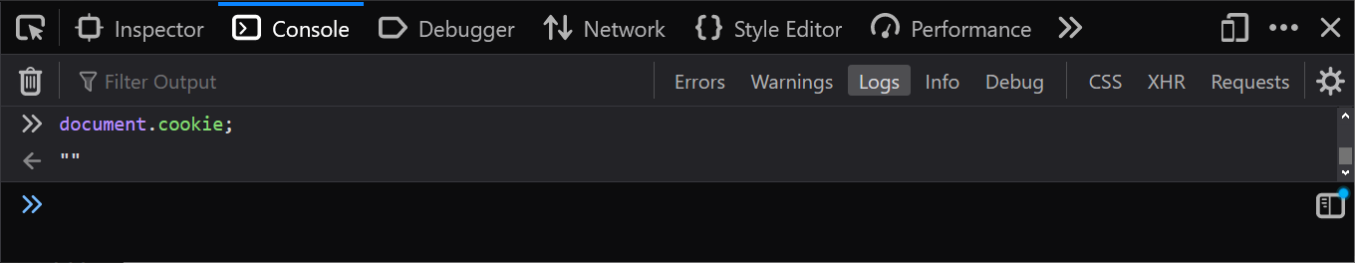
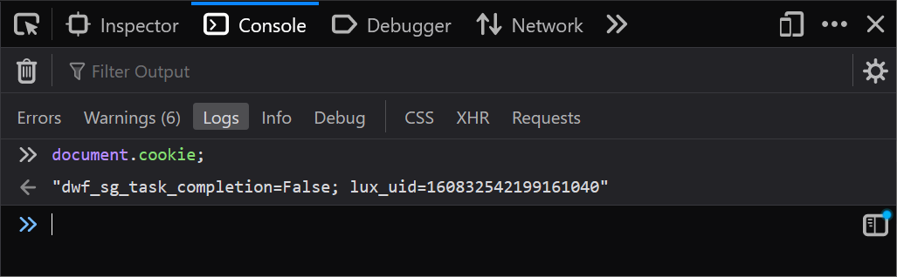
Reading Cookie Data in JavaScript
So far as your browser-accessible JavaScript program is concerned, cookies are accessible via the document.cookie property.
document.cookie contains a string representation of all current cookie data for the current site / domain.
If there is no cookie data, you’ll be met with an empty string. If there is cookie data, you’ll see key-value pairs one after another as a string. Keys and values are separated via equal signs (=), and each pairing is separated by a semicolon (;).
Accessing document.cookie to read all cookies available in the current context.
Notes:
The first example was from a local HTML file, the second was from the Mozilla Developer Network website.

Slide 6
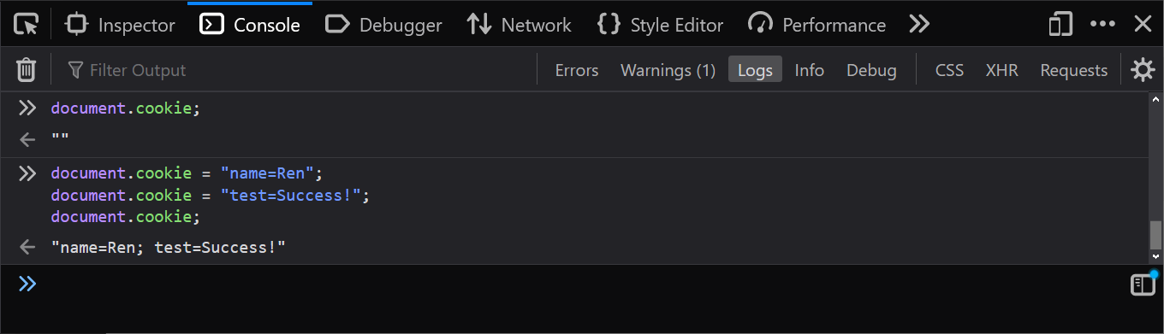
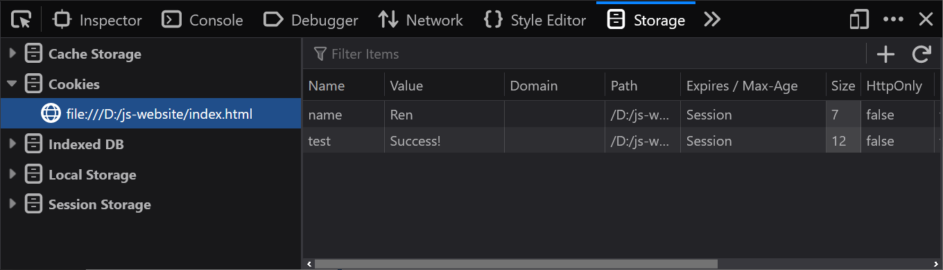
Adding Cookies via JavaScript
When assigning a cookie it is important to follow the expected formatting.
The string you assign should consist of the key name, an equal sign, and finally the value you’d like to associate with that key.
If added one at a time in this fashion, note that you do not need to succeed the value with a semicolon—it will display for you when calling upon the list (string) of cookies.
To assign a new cookie, we can follow document.cookie with an assignment.

Slide 7
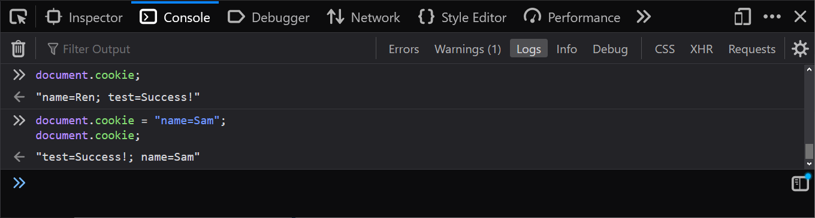
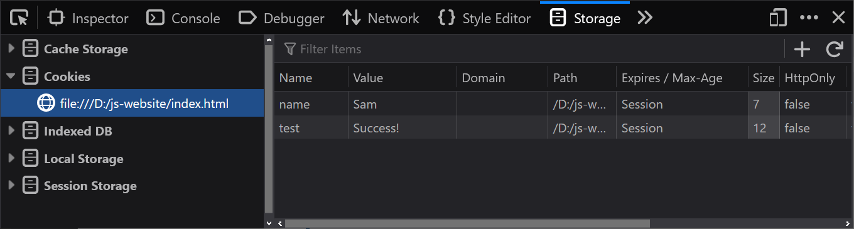
Updating a Cookie’s Value
A cookie’s value isn’t set in stone. We can reassign it if or when we need to.
Simply and thankfully, it is the same process as the initial assignment!
To reassign a cookie, we can follow document.cookie with an assignment like before; ensure the key name in your string matches your target cookie.

Slide 8
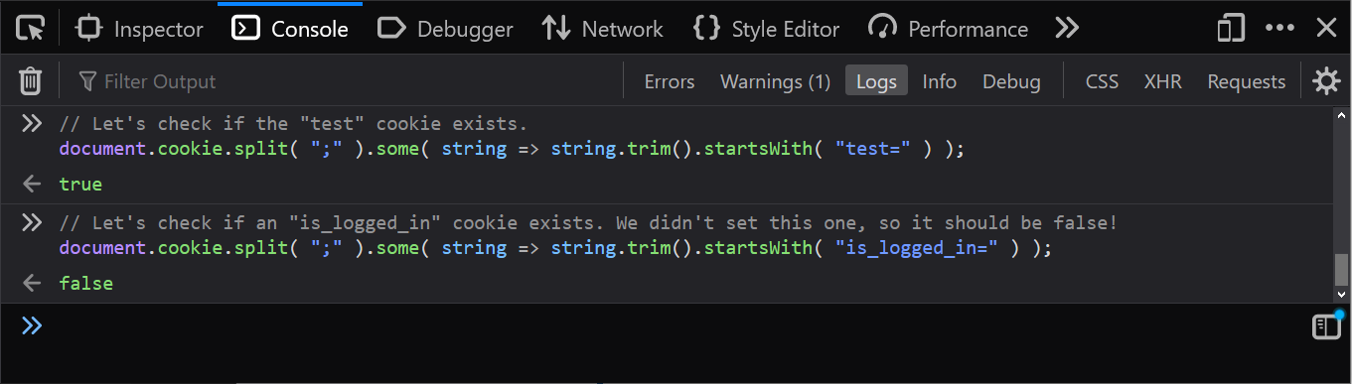
Check if a Cookie Exists
document.cookie gives us a string representation of the key-value pairs that each cookie is made up of. If we want to check if there is a particular key-value pair—cookie—present and available to us (usually for “if” statements / decisions), we can use the following…
split() Cut up the string based on the cookie separator character (semicolon); returns an array of strings.
some() Check each of these key-value pairs (strings) in the array for at least one match. Returns true if there is even one success.
startsWith() Returns a success if the key-value pair starts with the target key name.
This isn’t a built-in feature, but with a little code we can quickly check by name if a cookie exists!
Notes:
Consider packing this into a little function you can re-use in cookie-intensive projects!
Note that we are using an anonymous arrow function inside of the some() array method. You may use a named function instead if it is easier for you, or you end up using the same functionality elsewhere.
document.cookie.split( ";" ).some( string => string.trim().startsWith( "KEY=" ) );

Slide 9
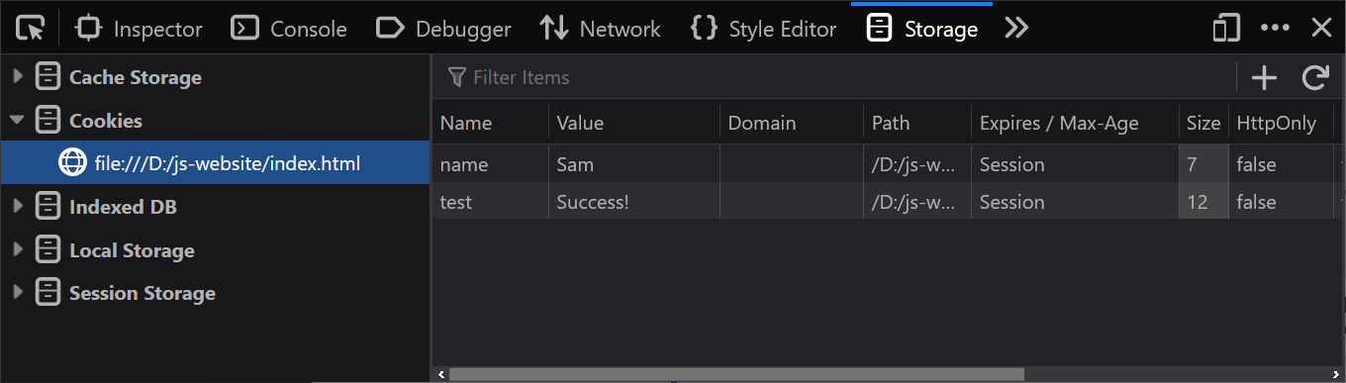
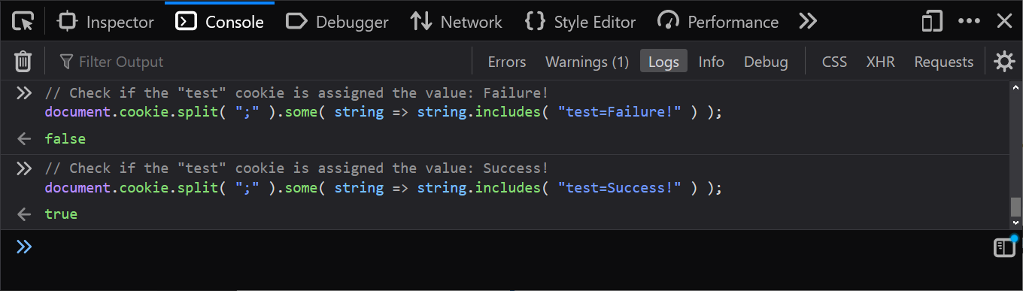
Check if a Specific Cookie is Assigned a Specific Value
Much like checking for existence of a cookie, here we’ll still want to split the string into an array, and use some() to check for any matches.
It is the match criteria itself that will change. This time, instead of using both trim() and startsWith(), we can get away with using just includes().
This, as well, is not a built-in feature, but with a little code we can quickly check by name if a cookie has the value we’re checking for!
Notes:
document.cookie.split( ";" ).some( string => string.includes( "KEY=VALUE" ) );

Slide 10
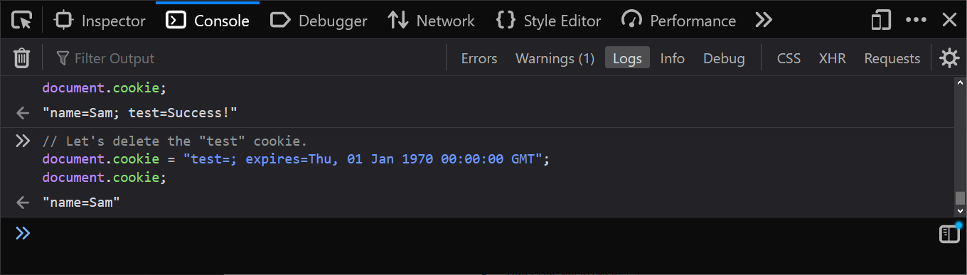
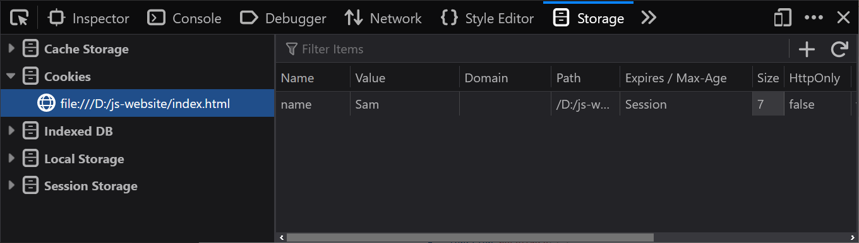
Reset or Clear a Cookie
Resetting looks much like declaring or reassigning a cookie, but we set it to an empty value.
It is best to also give it an expiration date that is well into the past to force its dismissal by the browser (expired cookies are deleted by the browser.)
Let’s tell a cookie that it is time to retire.

Slide 11
Web Storage

Slide 12
What is Web Storage?
The Web Storage API afforded to JavaScript gives us (at the time of writing this slide) two different browser Storage objects to work with:
sessionStorage Origin-specific storage that persists until the tab closes. Different storage instance on a per tab basis.
localStorage Origin-specific storage that persists even if the browser itself is closed.
A notable difference between cookies and these storage solutions is that cookie data can be shared and even updated based on web server responses (not just JavaScript.)
Web storage is stored on the client / browser device for local reference, and won’t be shared in requests and responses to/from the web server by default. Barring use of ajax, this data won’t do much travelling.
You’ll often see it used for describing user-specific setting data that may be used page-to-page throughout a website.

Slide 13
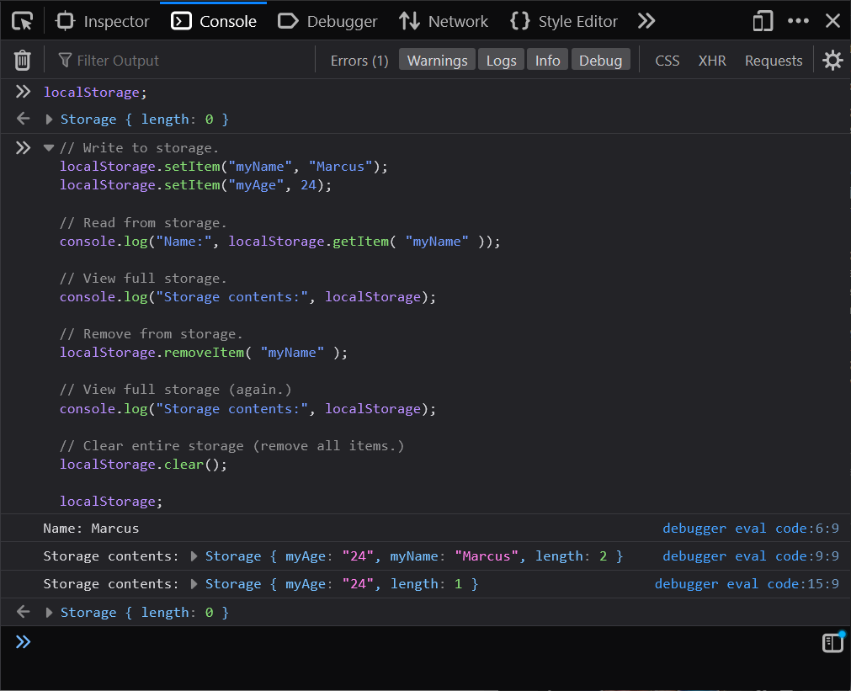
The Basics of Web Storage
For the full article on what you can do, check out “Using the Web Storage API”. These steps look the same for both localStorage and sessionStorage.
Similar to the way a Map works, we use methods to set, get, and remove values in the storage based on key names.
Notes:
// Write to storage.
localStorage.setItem("myName", "Marcus");
localStorage.setItem("myAge", 24);
// Read from storage.
console.log("Name:", localStorage.getItem( "myName" ));
// View full storage.
console.log("Storage contents:", localStorage);
// Remove from storage.
localStorage.removeItem( "myName" );
// View full storage (again.)
console.log("Storage contents:", localStorage);
// Clear entire storage (remove all items.)
localStorage.clear();
localStorage;

